Slide 1
Image Enhancement in the Spatial Domain
(chapter 3)
Most slides stolen from Gonzalez & Woods, Steve Seitz and Alexei Efros
Math 5467, Spring 2008

Slide 2
Image Enhancement (Spatial)
Image enhancement:
Improving the interpretability or perception of information in images for human viewers
Providing `better' input for other automated image processing techniques
Spatial domain methods:
operate directly on pixels
Frequency domain methods:
operate on the Fourier transform of an image

Slide 3
Point Processing
The simplest kind of range transformations are these independent of position x,y:
g = T(f)
This is called point processing.
Important: every pixel for himself – spatial information completely lost!

Slide 4
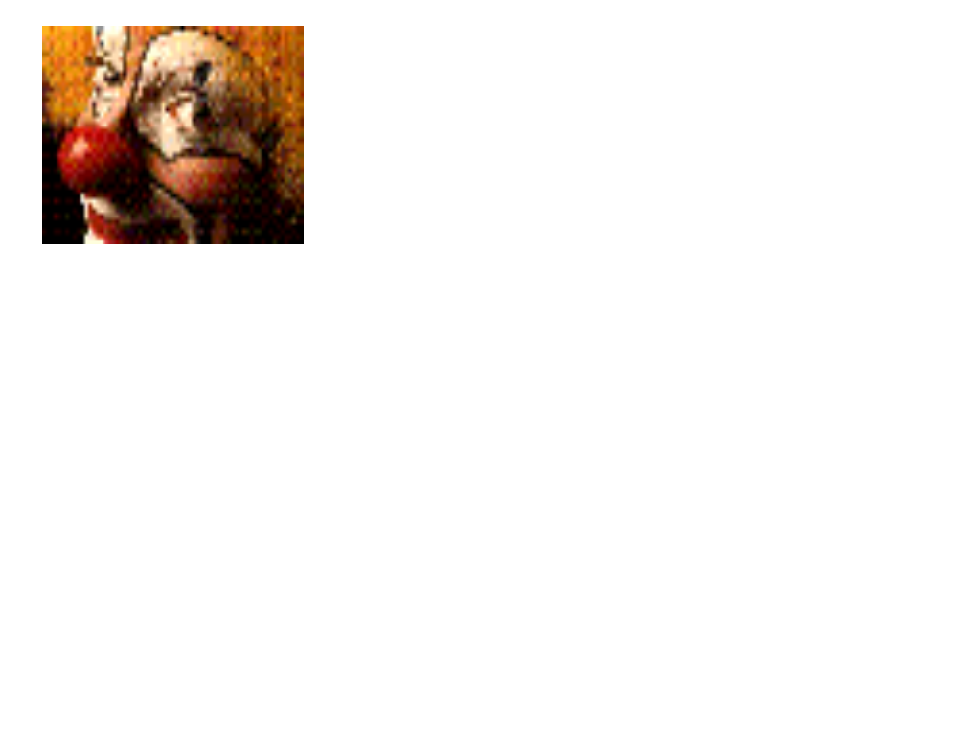

Obstacle with point processing
Assume that f is the clown image and T is a random function and apply g = T(f):
What we take from this?
May need spatial information
Need to restrict the class of transformation, e.g. assume monotonicity

Slide 5
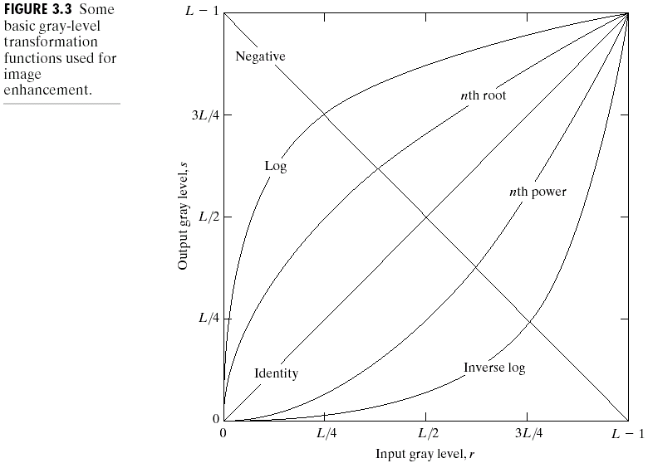
Basic Point Processing

Slide 6
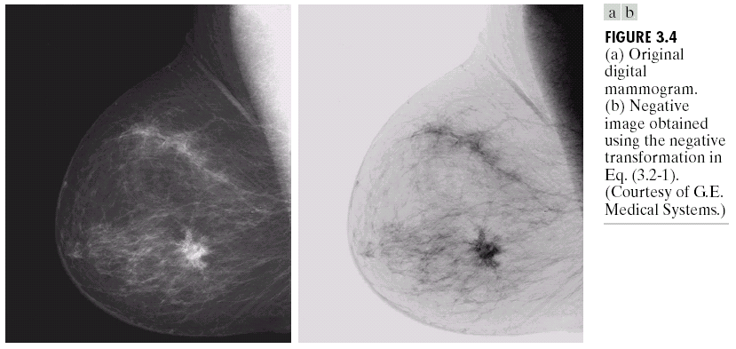
Negative

Slide 7
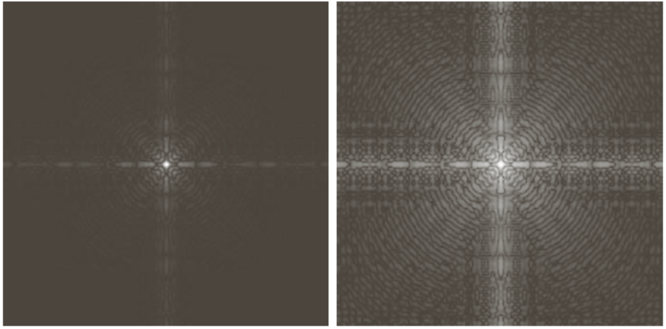
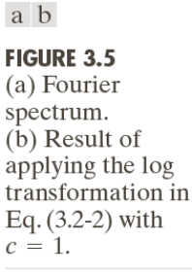
Log Transform

Slide 8
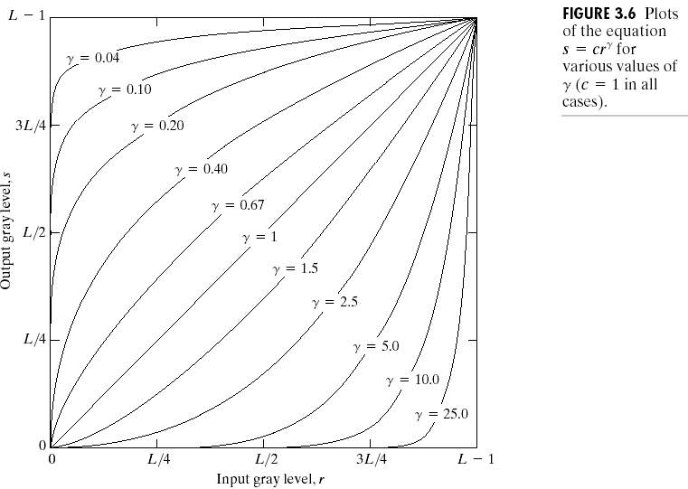
Power-law transformations

Slide 9
Why power laws are popular?
A cathode ray tube (CRT), for example, converts a video signal to light in a nonlinear way. The light intensity I is proportional to a power (γ) of the source voltage VS
For a computer CRT, γ is about 2.2
Viewing images properly on monitors requires γ-correction

Slide 10
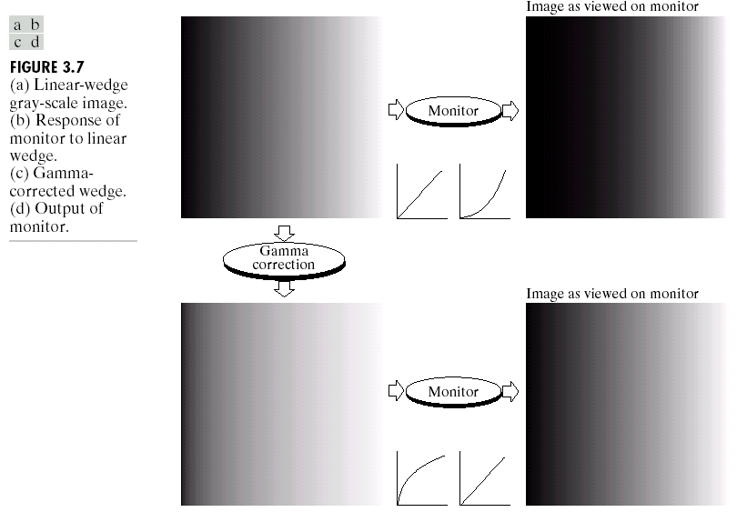
Gamma Correction
Gamma Measuring Applet:
http://www.cs.cmu.edu/~efros/java/gamma/gamma.html

Slide 11
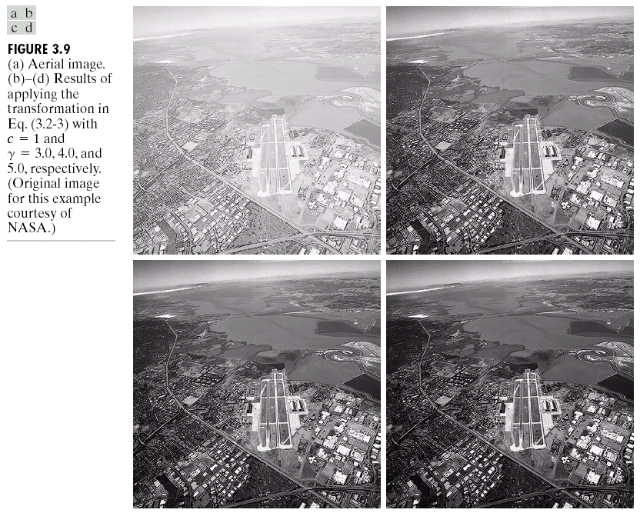
Image Enhancement

Slide 12

Contrast Streching

Slide 13
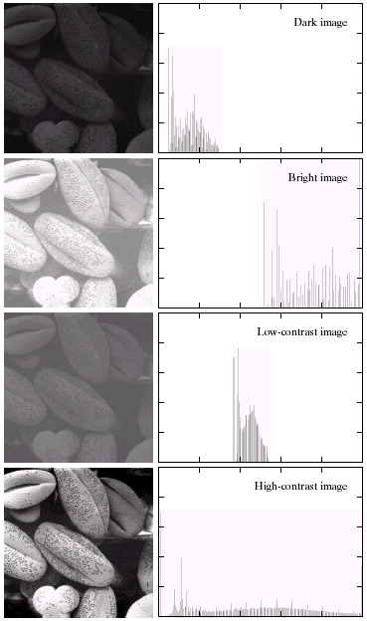

Image Histograms
x-axis – values of intensities
y-axis – their frequencies

Slide 14
Back to previous example
The following two images
have the same histograms…

Slide 15
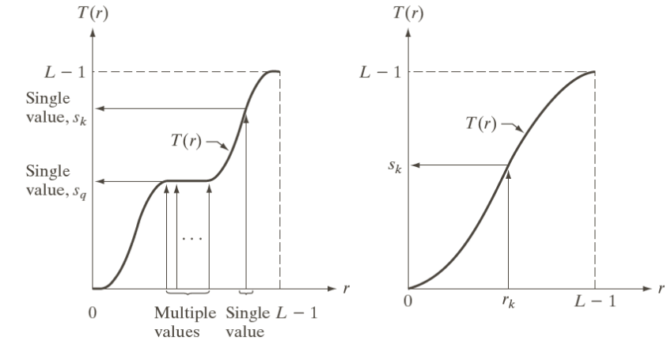
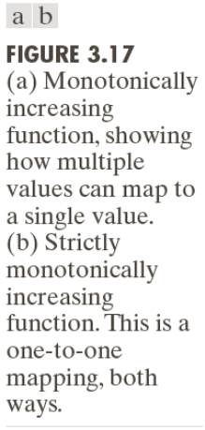
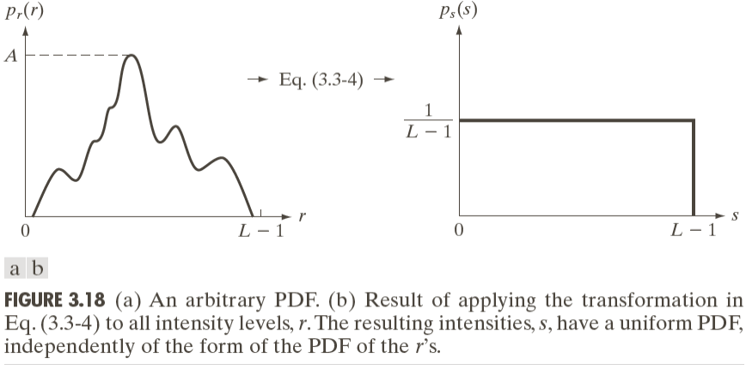
Histogram Equalization (Idea)
Idea: apply a monotone transform resulting in an approximately uniform histogram

Slide 16
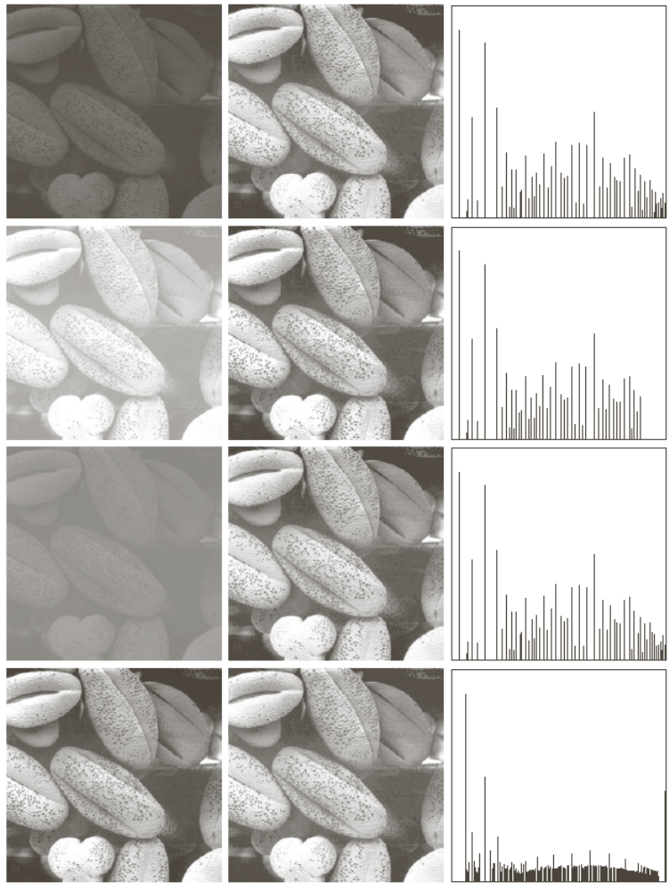
Histogram Equalization

Slide 17
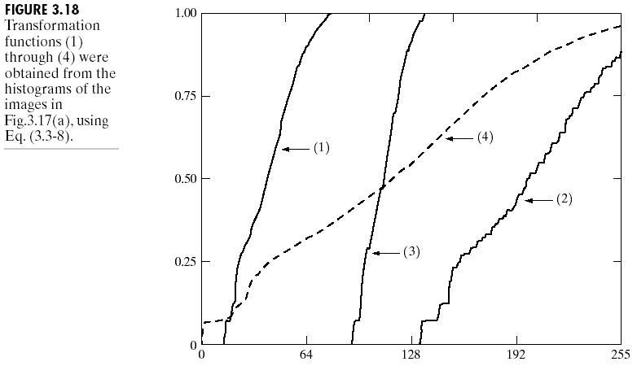
Cumulative Histograms

Slide 18
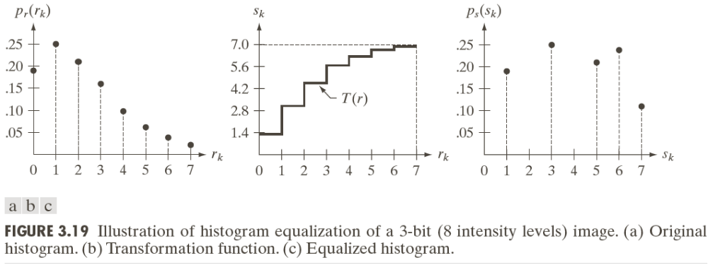
How and why does it work ?
Why does it work: (to be explained in class)

